Slide 1

Annual Forum for
Equal Opportunities of the
Business Advisory Board on Disabilities
Jill Houghton, President & CEO

Slide 2

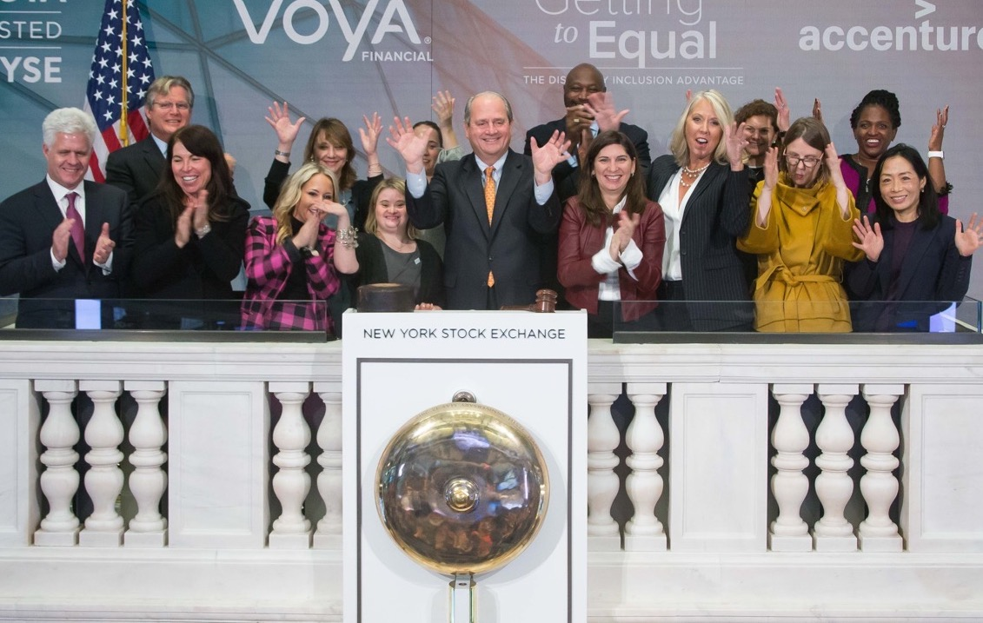
THE LEADING NONPROFIT RESOURCE FOR BUSINESS DISABILITY INCLUSION WORLDWIDE.
We empower business to achieve disability inclusion and equality.
Our network of more than 220 corporations expands opportunities for people with disabilities across enterprises.
Our organization and 27 Affiliates raise a collective voice of positive change for people with disabilities in business.
Learn more at: DisabilityIN.org
Notes:
DEEP DIVE

Slide 3


WHY ADVANCE
DISABILITY INCLUSION?
DISABILITY FACTS
70%
1 in 4 Have a Disability
of Disabilities are Non-Apparent
Globally… We are 1 Billion Strong
3

Slide 4

BETTER PERFORMANCE & SUSTAINABILITY
“THE DISABILITY INCLUSION ADVANTAGE”
28%
HIGHER REVENUE
30%
BETTER PERFORMANCE ON ECONOMIC PROFIT MARGINS
2X
HIGHER NET INCOME

Slide 5

Starting the
Journey

Slide 6



THE DEI
The Disability Equality Index (DEI) is an annual benchmarking tool that gives U.S. businesses an objective score and roadmap on their disability inclusion policies and practices.
A JOINT INITIATIVE:

Slide 7
DEI – DEEP DIVE
WHAT IS THE DEI?
Tool to educate the business community on disability inclusion best practices
OVER 150 Fortune 1000 companies participate
Enabler for defining and developing a roadmap for disability inclusion
Measures 6 key areas across the organization, most comprehensive index
WHAT DOES IT MEASURE?
Culture and Leadership
Enterprise-Wide Access
Employment Practices
Community Engagement
Supplier Diversity
Non-U.S. Operations (not weighted)
Notes:
Need knockout logos of DEI, AAPD and Disability:IN

Slide 8
ACTION INSIDE THE DEI:
BUILDING A ROADMAP
Disability Equality Index Points Distribution (100 Total)
NON-U.S.
OPERATIONS,
NOT WEIGHTED
CULTURE, 20
LEADERSHIP,
10
BENEFITS,
10
RECRUITMENT,
10
EMPLOYMENT,
EDUCATION,
RETENTION &
ADVANCEMENT
10
ACCOMMODATIONS,
10
8

Slide 9
DEI PARTICIPATION GROWTH
9

Slide 10
TOP PARTICIPATING INDUSTRIES
Other Represented Industries:
Legal, Entertainment & Leisure, Media, Agriculture, Airlines, Hotels / Resorts / Casinos, Real Estate, Travel, Advertising & Marketing, Automotive, Consumer Products, Oil & Gas, Chemical, Engineering & Construction, Information Services, and Mail & Freight Delivery.

Slide 11


















2020 COMPANIES EARNING 100
11

Slide 12













2020 COMPANIES EARNING 100 (CONTINUED)
12

Slide 13





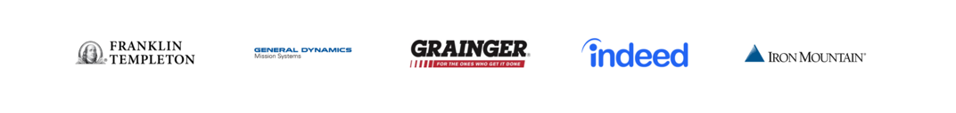



2020 COMPANIES EARNING 90

Slide 14
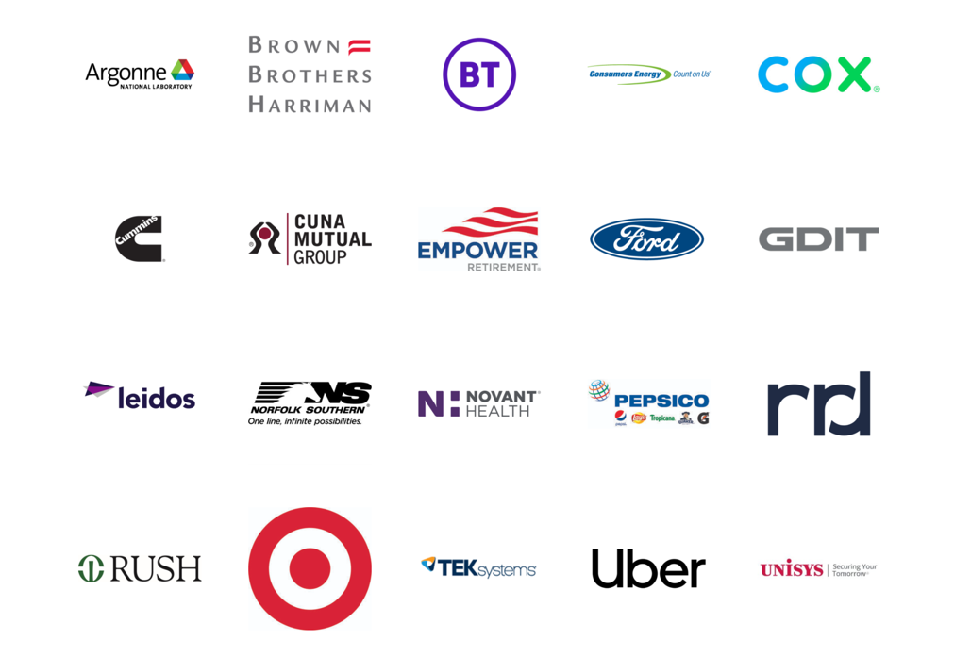

2020 COMPANIES EARNING 80

Slide 15
Disability: INternational
In a global marketplace, equality knows no borders.
What began as largely U.S. efforts to create disability-inclusive workplaces is now a much larger conversation.
In 2020, 75% of participating DEI companies have operations outside of the U.S.

Slide 16
2020 DEI: INTERNATIONAL
75% of Multinational Companies Have Disability Inclusive Non-Discrimination Policies
75% Have Ops Outside of the U.S.
7.5 Million International Workforce
42% of Multinational Companies Have a Disability-Focused ERG
Notes:
In 2020, 75% of participating DEI companies have operations outside of the U.S.
Of the non-U.S.-based employees 186 companies who said they have operations outside of the United States, there’s a non-U.S. workforce representation of 7,496,147.
75% of multinational companies reported operations outside of the U.S. have disability inclusive standards of non-discrimination in the workplace for all employees compared to 69% in 2019.
42% of multinational companies also report their non-U.S. operations have established disability-focused Employee Resource Group (ERG) or Affinity Group chapters, compared to 41% in 2019.

Slide 17
WHO’S IN?
JOINING THE ARE YOU IN? CAMPAIGN
JOIN IN THE INTERNATIONAL CAMPAIGN FOR DISABILITY INCLUSION
We all have a role to play in building an inclusive global economy. Join IN!
Visit INforInclusion.org

Slide 18
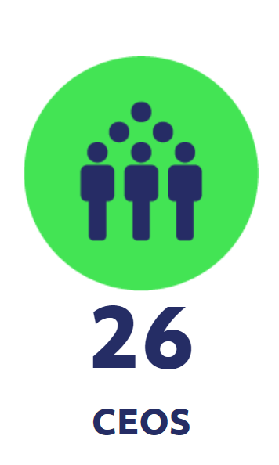
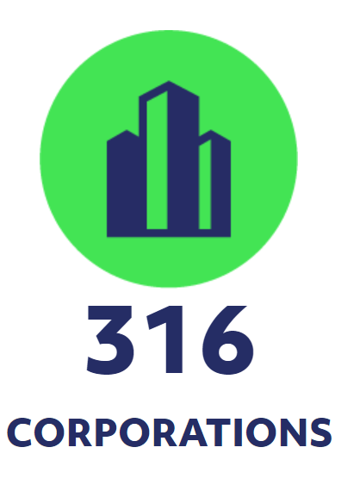
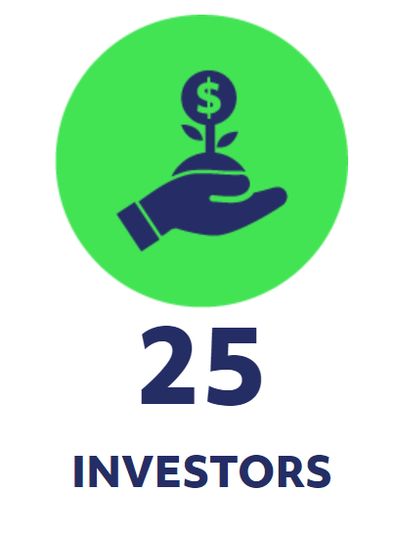
WHO’S IN?

Slide 19
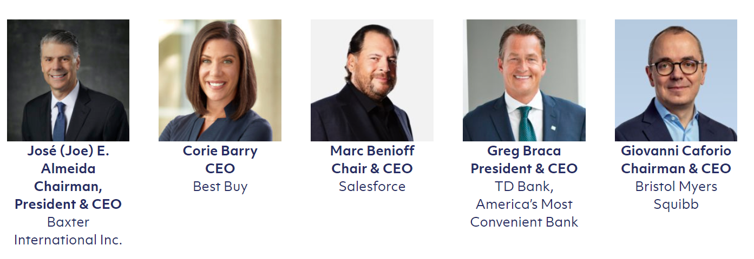
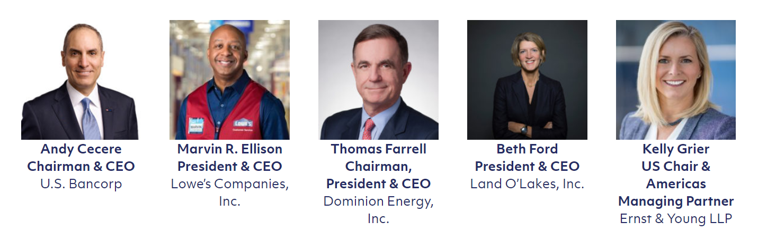
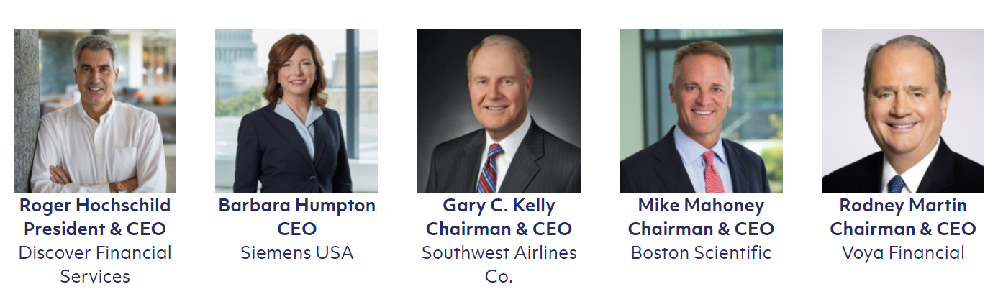
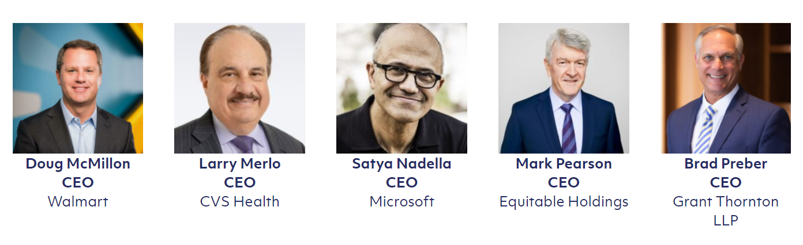
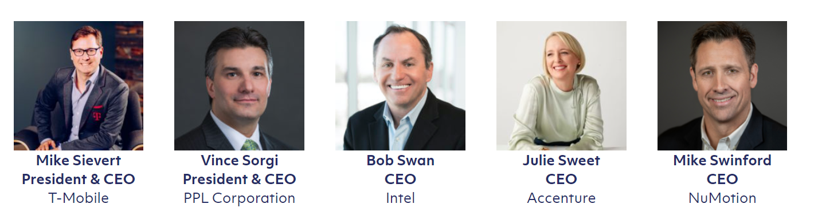
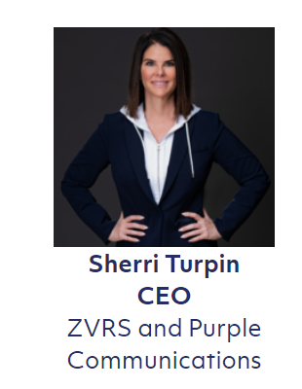
26 CEOs ARE IN

Slide 20
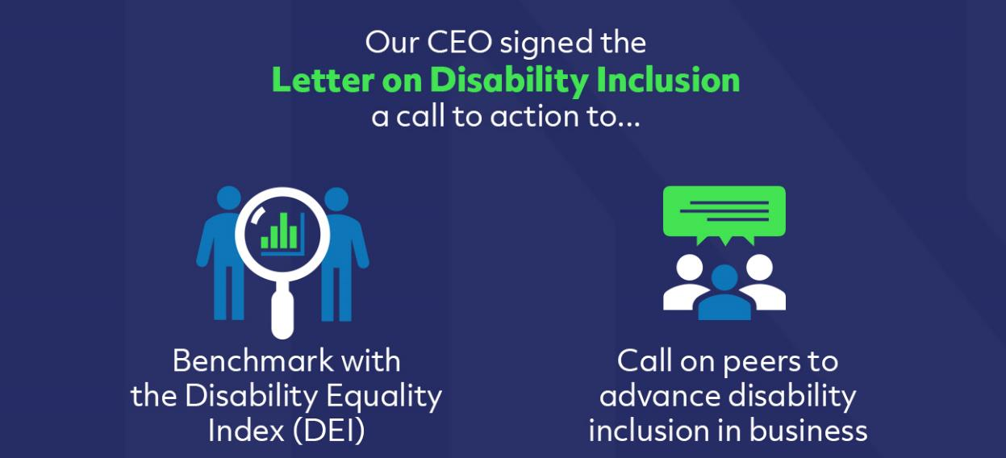
MORE TO BE ANNOUNCED

Slide 21
25 INVESTORS are IN
Managing over $2.8 Trillion Dollars
Bank of America
Rodney O. Martin, Jr., Chairman and Chief Executive Officer,
Voya Financial, Inc.
Dieter Waizenegger, Executive Director,
CtW Investment Group
Christopher J. Ailman, FSA, Chief Investment Officer,
California State Teachers’ Retirement System (CalSTRS)
Thomas P. DiNapoli,
New York State Comptroller
Scott M. Stringer,
New York City Comptroller
Tobias Read,
Oregon State Treasurer
Shawn T. Wooden,
Connecticut State Treasurer
Michael W. Frerichs,
Illinois State Treasurer
Deborah B. Goldberg,
Massachusetts State Treasurer
Joseph M. Torsella,
Pennsylvania State Treasurer
Thomas “Thom” Williams, Executive Director,
Employees’ Retirement System of the State of Hawaii
Richard Trumka, President,
American Federation of Labor and Congress of Industrial Organizations (AFL-CIO)
Xander den Uyl, Vicechair,
Pension Fund PWRI, The Netherland*
Seth Magaziner,
Rhode Island State Treasurer
Sheila Morgan-Johnson, Executive Director,
District of Columbia Retirement Board
Clifton S. Robbins, Chief Executive Officer,
Blue Harbour Group, L.P.
Beth Pearce,
Vermont State Treasurer
Brian Bodager, Chief Executive Officer,
The Pension Boards-UCC, Inc.
Matthew W. Patsky, Chief Executive Officer,
Trillium Asset Management LLC
Boston Common Asset Management Group
Carole Liable, Chief Executive Officer,
Domini Impact Investments LLC
Matt Nacard, Chief Executive Officer,
Ethical Partners Fund Management*
Julie Hammerman, Executive Director,
JLens
Sister Jean Steffes CSA, General Superior,
Congregation of Sisters of St. Agnes
*non-U.S
Notes:
Pension Fund PWRI – based in the Netherlands; Ethical Partners Fund Management based in Australia

Slide 22


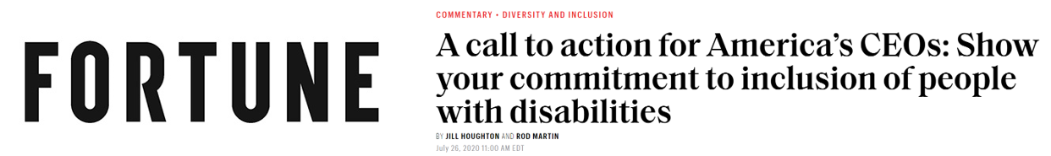
RECENT MEDIA

Slide 23
Resources
Notes:
Make two versions:
THIS comprehensive + Companies that take DEI that are not partners.
Promote during ADWEEK – Sept. 30th.

Slide 24
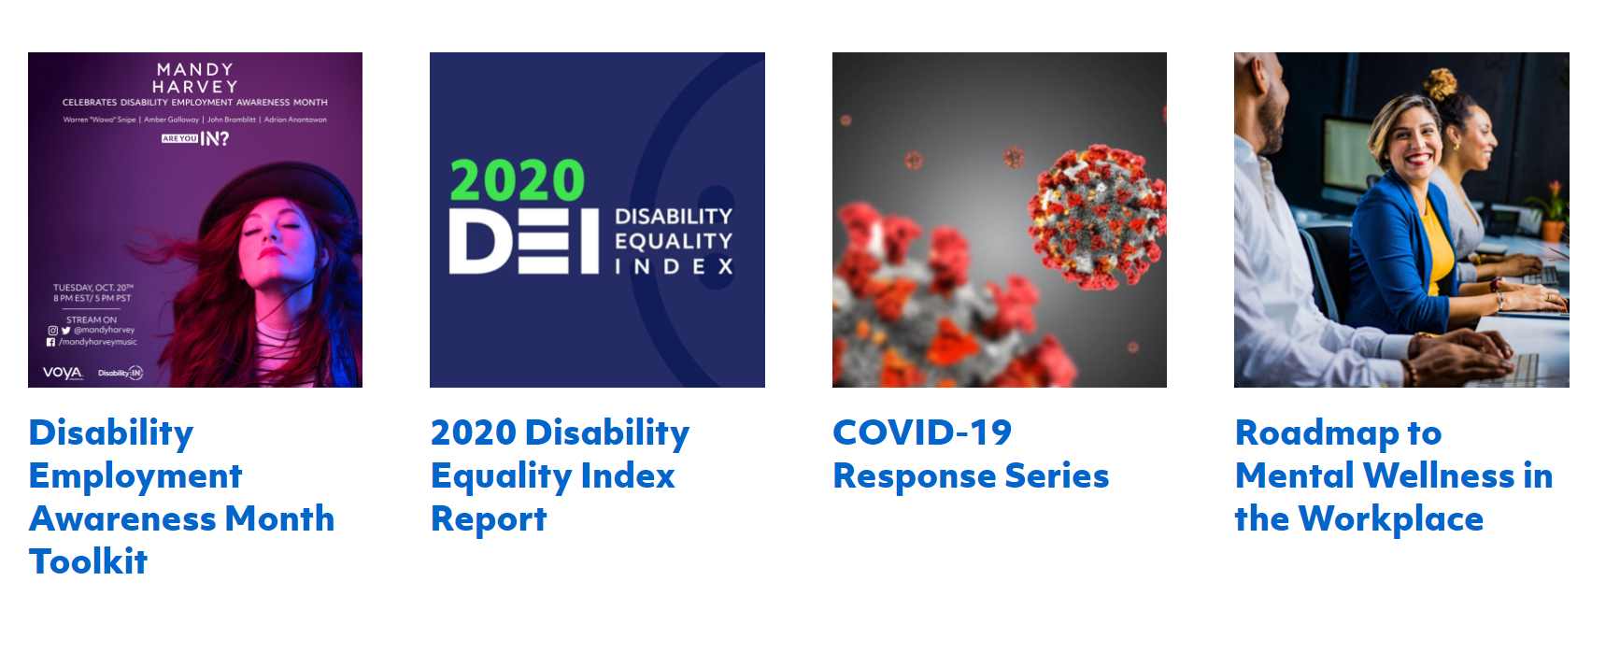
GENERAL RESOURCES
RESOURCE LIBRARY
Notes:
Mental Health, COVID response, Global, Procurement Toolkit.

Slide 25


INTERNATIONAL SCOPE
RESOURCE LIBRARY
Disability:IN Global Directory
Collaborative disability inclusion database with country profiles to help companies achieve disability inclusion and equality around the world.
Global Best Practices Report
This report highlights the global best practices of international companies that scored 80 or above on the 2019 DEI.
Notes:
Mental Health, COVID response, Global, Procurement Toolkit.

